Slide 1
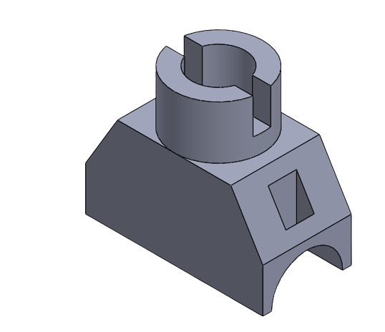
Isometric Projection/ Drawing
Prepared by:
Er. Bibek Magar
BE in Automobile Engineering
IOE, Thapathali Campus
bibek.magar@thc.tu.edu.np

Slide 2
Types of Projections
Projections
Parallel Projection
Central/ Perspective Projection
Orthographic Projection
Oblique Projection
Linear Perspective
Aerial Perspective
Cavalier Projection
Cabinet Projection
Clinographic Projection
Axonometric Projection
Multi-view Projection
Trimetric Projection
Dimetric Projection
Isometric Projection
Parallel (one point) Perspective
Angular (two point) Perspective
Oblique (three point) Perspective

Slide 3
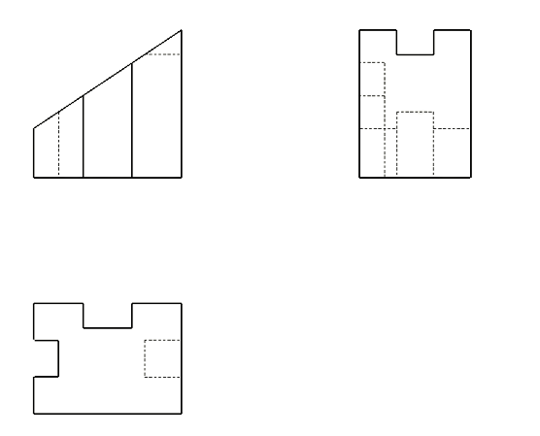
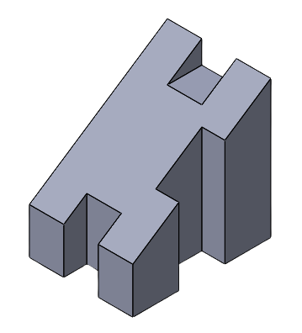
Isometric Projection
Isometric projection is an orthographic projection of an object on the vertical plane showing its three dimensions in one view (elevation).
It is a pictorial orthographic projection of an object in which a transparent cube containing the object is tilted until one of the solid diagonals of the cube becomes perpendicular to the vertical plane and the three axes are equally inclined to this vertical plane.

Slide 4
Principle of Isometric Projection:
d’
D
c’ , b’
B
C
a’ , b’
c’ , d’
a’
c’ , b’
d’
h’
A, H
a’
F
G
g’ , f’
30°
30°
e’
E
e’ , f’
g’ , h’
e’
g’ , f’
h’
VP
HP
b ,f
d ,h
b ,f
b
f
a
e
d
h
a ,e
d ,h
a ,e
c, g
c, g
c
g

Slide 5
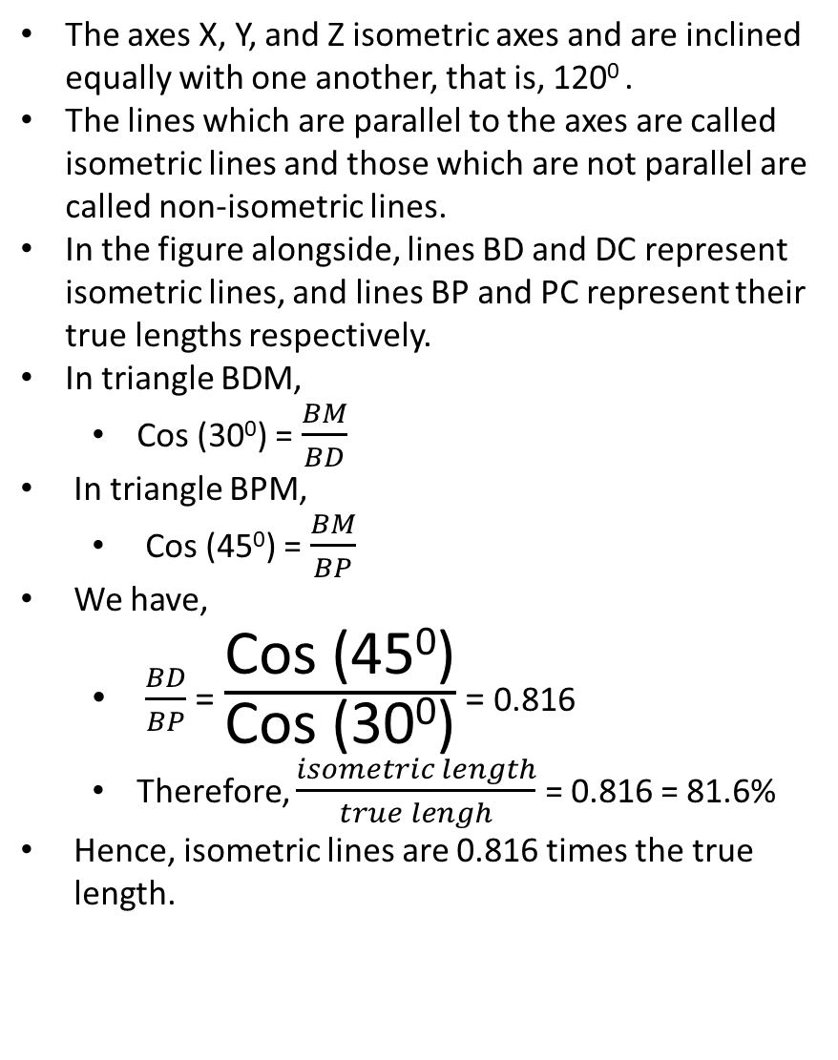
The axes X, Y, and Z isometric axes and are inclined equally with one another, that is, 120⁰ .
The lines which are parallel to the axes are called isometric lines and those which are not parallel are called non-isometric lines.
In the figure alongside, lines BD and DC represent isometric lines, and lines BP and PC represent their true lengths respectively.
In triangle BDM,
Cos (30⁰) = $\frac{BM}{BD}$
In triangle BPM,
Cos (45⁰) = $\frac{BM}{BP}$
We have,
$\frac{BD}{BP}$ = $\frac{\text{Cos}\text{ (450)}}{\text{Cos}\text{ (300)}}$ = 0.816
Therefore, $\frac{isometric length}{true lengh}$ = 0.816 = 81.6%
Hence, isometric lines are 0.816 times the true length.
P
D
45°
B
30°
C
M
Y-axis
X-axis
A, H
F
G
30°
30°
E
Z-axis

Slide 6
The extent of reduction of an isometric line can be easily found by construction of a diagram
called isometric scale.
4
3
2
45°
4
1
3
30°
2
1
True Scale
Isometric Scale

Slide 7
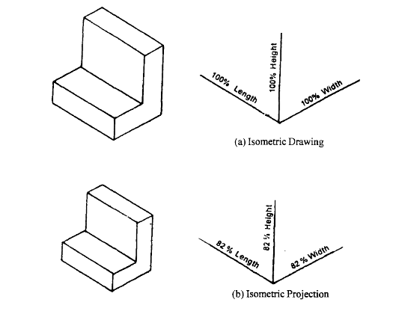
Isometric Drawing
Drawing of objects are seldom drawn in true isometric projections, as the use of an isometric scale is inconvenient. Instead, a convenient method in which the foreshortening of lengths is ignored and actual or true lengths are used to obtain the projections, called isometric drawing or isometric view is normally used.
The isometric drawing of figure is slightly larger (approximately 22%) than the isometric projection. As the proportions are the same, the increased size does not affect the pictorial value of the representation and at the same time, it may be done quickly.

Slide 8
General Rules for constructing isometric view/ drawing:
Isometric lines are drawn using their true length.
Non-isometric lines reduce according to the angle made by the line with the planes, so to draw the non-isometric lines their end points are located along the isometric lines (Either existing, or the lines are constructed).
Circle and Sphere are constructed using special methods which are discussed later in the chapter.
Hidden lines should not be drawn.

Slide 9
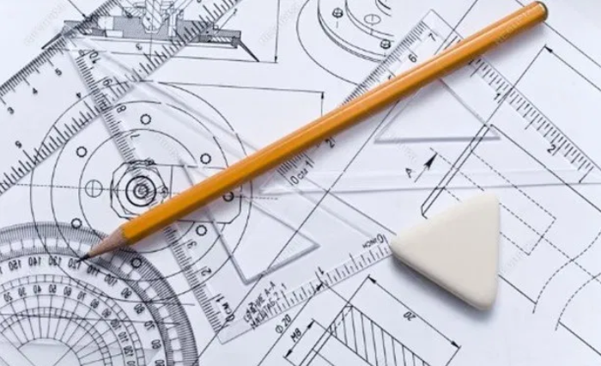
Solved Examples:

Slide 10
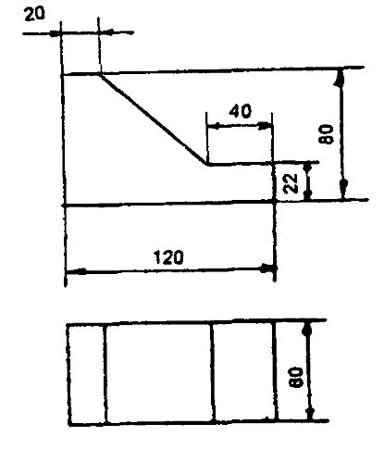
Q1) Draw isometric view of the object from the given orthographic views
Lines AF, GL, AB, GH, CD, IJ, DE, JK, EF, KL, AG, FL, BH, CI, DJ, and EK are isometric lines so they are drawn using their true length.
b’, h’
a’, g’
Lines BC, and HI are non-isometric lines, to draw them their end points are located along the isometric lines and connected.
d’, j’
c’, i’
f’, l’
e’, k’
g, l
h
i
j, k
a, f
b
c
d, e

Slide 11
Z-axis
Y-axis
X-axis
30°
30°

Slide 12


There are 4 possible solutions for the question:
Although all the solutions are technically correct some solutions are better than other. Can you identify them?
#2
#1
#1 and #2 are better solution since they show all the relevant features of the object
However, #3 and #4 are not good solutions since they don’t show the slope which is an important feature of this object.
#4
#3
Hence, the position of the object should be chosen such that maximum features of the object can be depicted in our isometric view.

Slide 13
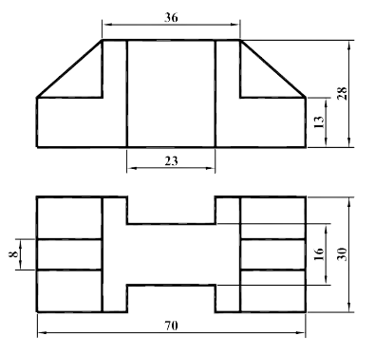
Q2) Draw isometric view of the object from the given orthographic views

Slide 15
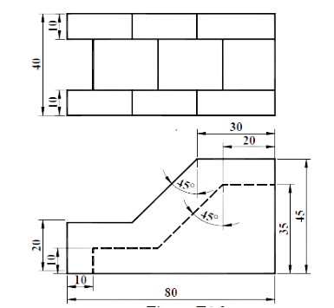
Q3) Draw isometric view of the object from the given orthographic views

Slide 17
Drawing a Circle in Isometric view
Draw a rhombus of size equal to the diameter of the circle which has to be drawn in isometric view
Locate the mid point for each side of the rhombus
Draw diagonals of the rhombus
m1
Draw lines from the end points of the shortest diagonal such that they are connected to m1 and m4, and m3 and m2.
m3
c3
c2
Thus, 4 centers i.e., c1, c2, c3 and c4 are located and isometric circle can be drawn using the 4 center method.
m4
c1
c4
m2

Slide 18
Solved Examples:

Slide 19
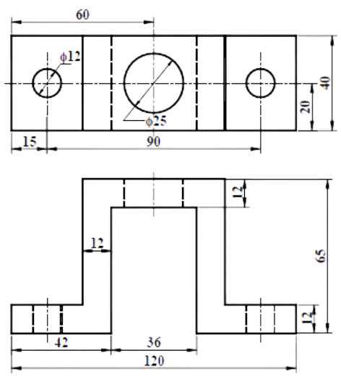
Q4) Draw isometric view of the object from the given orthographic views

Slide 21
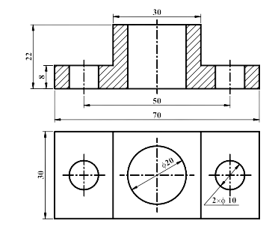
Q5) Draw sectional isometric view of the object from the given orthographic views

Slide 24
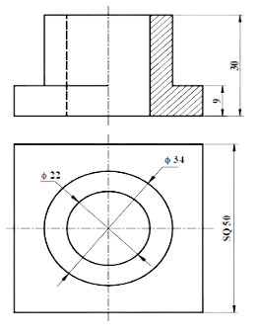
Q6) Draw sectional isometric view of the object from the given orthographic views

Slide 27
Q7) Draw the isometric view of a pentagonal plane of 30mm side when one of its sides is parallel to H.P, (a) When it is horizontal and (b)vertical.
Only one of the side of the pentagon can be considered an isometric while other four are no isometric lines
So to draw the non-isometric lines, we construct isometric lines which contains the end points of those lines
W
D
W
D
X
W
E
X
E
D
E
C
Z
C
Z
X
A
A
C
Y
B
B
Z
A
B
Y
Y

Slide 28
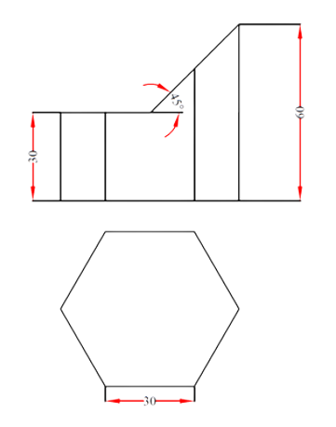
Q8) Draw isometric view of the object from the given orthographic views

Slide 31
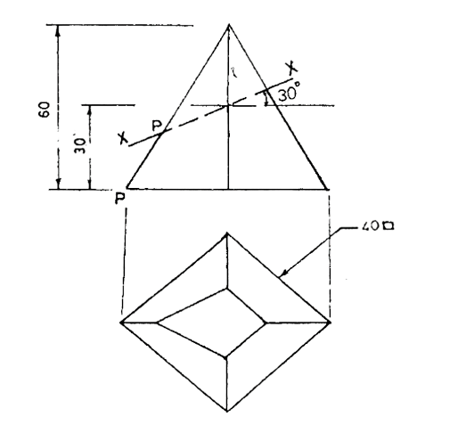
Q9) Draw isometric view of the object from the given orthographic views

Slide 34
Drawing a Sphere in Isometric Drawing

Slide 35
Solved Examples:

Slide 36
Q10) Draw isometric view of a sphere having radius of 50.
Draw an isometric circle( ellipse) of the given radius
Using the length of the major axis of the ellipse (isometric circle) as the diameter, draw a circle which represents the required isometric sphere.

Slide 37
Q11) A cylindrical slab of 70 mm as diameter and 40 mm thickness is surmounted by a frustum of a square pyramid of base side 50 mm, top base side 25 mm and height 40 mm. The axes of the two solids are on a common straight line. A sphere of diameter 40mm is centrally placed on top of the frustum. Draw the isometric view of the solids.

Slide 38


